Slide 1
Medicare Enrollment Periods Part C & Part D Election Periods Special Elections Periods (SEPs)
Presented by xxx
2018

Slide 2
Agenda
Introduction
Medicare Enrollment Periods (Part A and Part B)
Late Enrollment Penalty (Part B and Part D)
Election periods for MAPD and PDP plans (Part C and Part D)
Election period examples
Initial Enrollment Periods (IEP/ICEP)
Special Enrollment Periods (SEP)
Annual Enrollment Period (AEP)
Medicare Advantage Disenrollment Period (MADP)
Common reasons for application denial
Wrap up

Slide 3
Medicare Enrollment Periods
(Part A and Part B)

Slide 4
Enrollment periods
It is important to understand the difference between the following:
Medicare enrollment periods
The available timeframe that a beneficiary can enroll into Part A and/or Part B of Medicare.
Part C, also known as Medicare Advantage (MA/MAPD), and Part D (PDP) election periods
The available timeframes that an eligible Medicare beneficiary can enroll (or elect) a specific health plan to help cover their Medicare approved medical and/or pharmacy services.
Information on the following slides is taken directly from www.mymedicarematters.org/enrollment/when-can-i-enroll/
Sponsored by the National Council on Aging
Notes:
Medicare beneficiaries need to be enrolled into Medicare Part A and/or Part B to be eligible to join and MAPD or PDP plan. Timeframes to enroll into Medicare itself can vary from election periods. While some enrollment periods are referenced the same for both situations, it is important to understand the difference in timeframe and eligibility for a health plan.
Medicare enrollment period information on the following slides has been taken directly from My Medicare Matters.org

Slide 5
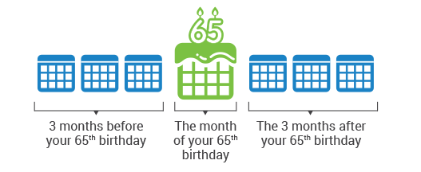
Medicare enrollment periods www.mymedicarematters.org/enrollment/when-can-i-enroll/
Initial Enrollment Period
The Initial Enrollment Period (IEP) is the first time you can sign up for Medicare. You may join Medicare Parts A, B, C and D during this time:
The 3 months before your 65th birthday,
The month of your birthday, and
The 3 months after your birthday.

Slide 6
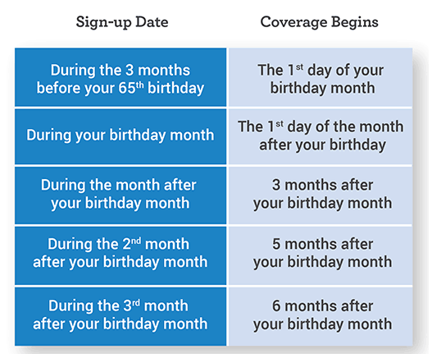
Medicare enrollment periods www.mymedicarematters.org/enrollment/when-can-i-enroll/
Part B effective date of coverage will depend on the month in which you enrolled during the Initial Enrollment Period

Slide 7
Medicare enrollment periods www.mymedicarematters.org/enrollment/when-can-i-enroll/
Special Enrollment Periods
There are Special Enrollment Periods (SEPs) that apply when you are able to delay your enrollment in Medicare Parts A, B, C & D. These SEPs are only available for certain circumstances.

Slide 8
Medicare enrollment periods www.mymedicarematters.org/enrollment/when-can-i-enroll/
Special Enrollment Periods
You may have waited to sign up for Medicare Part A (hospital service) and/or Part B (outpatient medical services) if you were working for an employer with more than 20 employees when you turned 65, and had healthcare coverage through your job or union, or through your spouse’s job.
You can get a Special Enrollment Period to sign up for Parts A and/or B:
Any time you are still covered by the employer or union group health plan through you or your spouse’s current or active employment, OR
During the 8 months following the month the employer or union group health plan coverage ends, or when the employment ends (whichever is first).
If you wait longer, you may have to pay a penalty when you join.
If you are disabled and working (or you have coverage from a working family member), the Special Enrollment Period rules also apply as long as the employer has more than 100 employees.

Slide 9
Medicare enrollment periods www.mymedicarematters.org/enrollment/when-can-i-enroll/
General Enrollment Period
If you miss your Initial Enrollment Period or your Special Enrollment Period, you get another chance to enroll.
You can sign up for Medicare Parts A & B between January 1 and March 31 each year. Your Medicare coverage would begin on July 1 of the same year.
It is important to note that if you need to buy Part A, you must also enroll in Part B at this time.

Slide 10
Late Enrollment Penalty
(Part B and Part D)

Slide 11
Late enrollment penalty – Part B www.mymedicarematters.org/enrollment/when-can-i-enroll/
What is the Medicare Part B penalty
If you sign up late for Medicare Part B, you will have to pay a late penalty premium every month for the rest of your life, along with your Part B premium. Your monthly Part B premium will go up 10% for each full 12-month period that you could have had Medicare Part B but did not take it. You will pay this higher premium as long as you have Medicare Part B.
You may not have to pay the penalty if you qualify for a Special Enrollment Period (SEP). You might qualify for an SEP if you had health insurance through your job or your spouse’s job when you were first eligible to sign up for Medicare Part B.

Slide 12
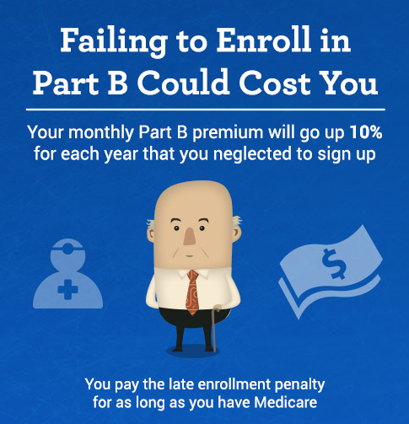
Late enrollment penalty – Part B www.mymedicarematters.org/enrollment/when-can-i-enroll/
There is a monthly premium for Part B coverage.
For Medicare beneficiaries with incomes below $85K/single or $170K/couple, the Part B premium cost for 2018 will average $134 per month.
Medicare beneficiaries with higher incomes, the Part B premium cost will range from $187.50 to $428.60 per month, based on income level.
Medicare beneficiaries who meet certain income and resource guidelines can get their Part B premium paid for by their state’s Medicare Savings Program.

Slide 13
Late enrollment penalty – Part B www.mymedicarematters.org/enrollment/when-can-i-enroll/
This sample chart illustrates a typical Part B penalty based on the average monthly Part B premium in 2018 of $134
1 | $ 13.40 | $ 160.80 | $ 804.00 | $ 1,608.00
3 | $ 40.20 | $ 482.40 | $ 2,412.00 | $ 4,824.00
5 | $ 67.00 | $ 804.00 | $ 4,020.00 | $ 8,040.00

Slide 14
Late enrollment penalty – Part D www.mymedicarematters.org/enrollment/when-can-i-enroll/
What is the Medicare Part D penalty
There is a late penalty premium for not joining a Medicare Part D drug plan when you first become eligible for Medicare. Generally, you are late if you did not join within 3 months after your Medicare Part A or Part B becomes effective.
You do not have to pay the penalty if you are eligible for the Extra Help with costs.
You may not have to pay the penalty if you qualify for a Special Enrollment Period (SEP) because you had other drug coverage that is as good as Medicare (creditable coverage) at the time you turned 65. Examples of creditable coverage include:
Coverage through your job or your spouse’s job, OR
Retiree coverage, OR
Coverage through the Veterans Administration.

Slide 15
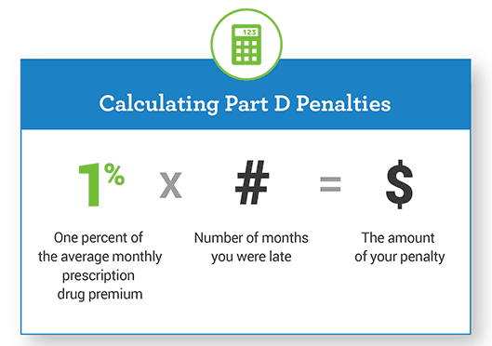
Late enrollment penalty – Part D www.mymedicarematters.org/enrollment/when-can-i-enroll/
The Part D penalty premium is added onto the regular premium that you pay to your Medicare drug plan.
The fee is calculated as 1% of the average monthly prescription drug premium (1% of $35.02 in 2018) times the number of months you were late, rounded to the nearest 10 cents.
This penalty is permanent – you would have to pay it for as long as you have Medicare Prescription Drug Coverage.
1% of $35.02 in 2018 | # of Months you were late | Monthly Penalty | Penalty cost over 1 year period
$0.35 | 12 | $4.20 | $50.40
$0.35 | 36 | $12.60 | $151.20
$0.35 | 60 | $21.00 | $252.00

Slide 16
Election Periods for MAPD and PDP plans
(Part C and Part D)

Slide 17
Use the correct election period
Eligible Client
Correct Election Period
Successful Enrollment
+
=

Slide 18
Guidance on selecting the correct election period
Help is available when you are in doubt of the correct election period.
Tip sheets are available
From your carrier partners
CMS bulletins
Medicare.gov
27

Slide 19
Election periods
An election period is a designated period of time that a Medicare beneficiary can "elect" to enroll in, disenroll from or make a plan change in a Medicare Advantage Plan or Medicare Prescription Drug Plan. There are different types of election periods based upon a beneficiary's circumstances. Each separate election period has its own rules regarding effective dates, disenrollment dates and eligibility factors.
The plan is responsible for determining the election period applicable to all enrollment and disenrollment requests. Plans may incorporate statements regarding the eligibility for an election period with the enrollment or disenrollment request. If request doesn't include this information, the plan’s enrollment specialist must contact the beneficiary to determine eligibility.

Slide 20
Election periods
There are six types of Medicare Advantage election periods, during which beneficiaries may make enrollment requests:
the Annual Election Period (AEP)
the Initial Coverage Election Period (ICEP)
the Initial Enrollment Period for Part D (IEP for Part D) – applies to MAPD enrollments only
the Open Enrollment for Institutionalized Individuals (OEPI)
all Special Election Periods (SEP), and
the Medicare Advantage Disenrollment Period (MADP)
.

Slide 21
Election periods
Once the plan determines the election period that applies to an election request, the plan must determine the effective date of the election.
With the exception of some SEPs and when election periods overlap, generally beneficiaries may not request their enrollment effective date.
If the beneficiary is eligible for more than one election period at the time he/she makes an election, resulting in more than one possible effective date, the plan must allow the beneficiary to choose the effective date. To accomplish this, the enrollment specialist must attempt to contact the beneficiary.
Note: This requirement doesn't apply to Group enrollments. A plan may submit these group enrollments to CMS with the EGHP SEP election.
.

Slide 22
Election periods
If the beneficiary is eligible for more than one election period, but doesn't indicate a preferred effective date or if the plan is unable to contact the beneficiary, the organization must assign an effective date using the following ranking of election periods. The election period with the highest rank generally determines the effective date of enrollment:
Ranking of Election Periods (highest to lowest):
ICEP/IEP for Part D
SEP
AEP / MADP
.

Slide 23
Election periods
Elections (enrollments/disenrollments/plan changes) must be made during a valid election period. In general, election periods offer one election that takes effect.
If the beneficiary changes his/her mind and wants to request a different election, this is permissible as long as the election period is still open and the prior selected plan hasn't yet become effective.
The last election received prior to the effective date (as determined by the application date) is the election that takes effect. Once an election becomes effective (for example, on January 1 for the Annual Election Period), the one available election for a particular election period has been used.
.

Slide 24
Medicare Advantage Disenrollment Period (MADP)
Since January 1, 2011, MA plan enrollees have had an annual opportunity to prospectively disenroll from any MA plan and return to Original Medicare between January 1 and February 14 of every year:
MADP disenrollments received in January are effective February 1.
MADP disenrollments received in February are effective March 1.
The MADP does not provide an opportunity to join or switch MA plans and members can't use the MADP to disenroll from a PDP plan.

Slide 25
Medicare Advantage Disenrollment Period (MADP)
MA-only and MAPD members who use the MADP to disenroll from a Medicare Advantage plan have a SEP that permits enrollment in a stand-alone PDP during the same MADP time frame. To use the SEP to enroll in a stand-alone PDP:
Medicare Advantage members may submit both the MADP disenrollment request and PDP enrollment request during the MADP timeframe or just submit the PDP enrollment during the MADP timeframe, which results in automatic termination of the MA plan and a return to Original Medicare.

Slide 26
Medicare Advantage Disenrollment Period (MADP)
The MADP disenrollment election to return to Original Medicare and use of the corresponding SEP to enroll in a stand-alone PDP may occur with different effective dates, as long as both elections occur during the MADP timeframe. For instance:
A beneficiary may use the MADP to disenroll from his/her MA plan - submitting the disenrollment in January results in a return to Original Medicare effective February 1.
The same beneficiary may use the corresponding SEP to enroll in a PDP during the MADP. The beneficiary has until February 14 to make this election – if the PDP election occurs in Feb (between Feb 1 – Feb 14), the PDP enrollment is effective March 1.

Slide 27
Election Periods for MAPD and PDP plans
(Part C and Part D)
examples and notes

Slide 28
MA/MAPD and PDP election periods – IEP/ICEP Part C and Part D
Situation
Plans
Enrollment Period
Notes
Newly eligible, turning 65
MA, MAPD, PDP
Initial Enrollment Period
(IEP)/Initial Coverage
Election Period (ICEP)
During the 7‐month period
that starts 3 months before
the month they turn 65,
includes the month they
turn 65, and ends 3 months
after the month they turn
65. ** ICEP can be separate
from IEP if member delays
enrolling into Part B.
Members cannot choose an effective date; it is locked in
based on the date of application or the date of the member’s eligibility.

Slide 29
MA/MAPD and PDP election periods – IEP/ICEP Part C and Part D
Situation
Plans
Enrollment Period
Notes
Newly eligible, disabled, under 65
MA, MAPD, PDP
Initial Enrollment Period (IEP)/Initial Coverage Election Period (ICEP)
The month of eligibility is the 25th month after a beneficiary receives Social Security or RRB disability benefits and they have a 7 month period to enroll in Medicare. The enrolment period begins 3 months before the month of eligibility (22nd month) and ends 3 months after the month of eligibility (28th month). **ICEP can be separate from IEP if member delays enrolling into Part B

Slide 30
MA/MAPD and PDP election periods – IEP/IEP Part C and Part D
Situation
Plans
Enrollment Period
Notes
Already eligible for Medicare because of a disability, and you turn 65
MA, MAPD, PDP or switch plans
2nd Initial Enrollment Period (2nd IEP)
During the 7-month period that starts 3 months before the month they turn 65, incudes the month they turn 65, and ends 3 months after they turn 65.
If enrolled in a PDP plan during their IEP they have used up their IEP but still have their ICEP available, which permits a change to and MAPD during the period. If the member is awarded Part B after their Part B effective date, the awards letter from Social Security must be attached to the application. The member has 60 days from the letter to apply for a plan. The effective date will be the first of the month following the application received date.

Slide 31
MA/MAPD and PDP election periods – IEP/IEP Part C and Part D
Situation
Plans
Enrollment Period
Notes
Have Medicare Part A coverage, and you get Part B for the first time
MA, MAPD, PDP*
*Even if the member is new to Part B, they are NOT necessarily new to PDP; this election period may not be applicable for PDP
Initial Coverage Election Period (ICEP) separate from IEP/General Enrollment Period
Normally occurs during General Enrollment Period 9April 1-June 30); otherwise 3 month period before Part B effective date
If someone enrolled for a PDP during initial enrollment, it does not disqualify the person from switching to an MAPD plan during the ICEP. Also, if the member is awarded Part B after their Part B effective date, the awards letter from Social Security must be attached to the application. The member has 60 days from the letter to apply for a plan.

Slide 32
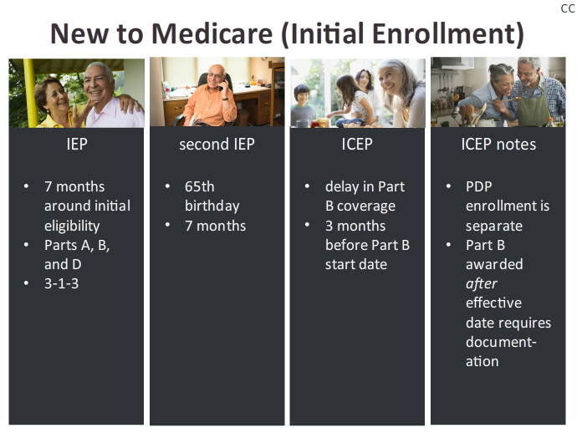
New to Medicare (Initial Enrollment) IEP or ICEP

Slide 33
MA/MAPD and PDP election periods – SEP Part C and Part D
Situation
Plans
Enrollment Period
Notes
Leave coverage from an employer or union
MA, MAPD, PDP
SEP – Loss of Employer Coverage
Their chance to join lasts for 2 full months after the month coverage ends.
Must include the date when member lost employer or union coverage

Slide 34
MA/MAPD and PDP election periods – SEP Part C and Part D
Situation
Plans
Enrollment Period
Notes
Involuntarily lose other drug coverage that is as good as Medicare drug coverage (Creditable Coverage), or other coverage changes and is no longer creditable.
MAPD, PDP
SEP – Creditable Coverage
Their chance to join lasts for 2 full months after the month they lose their creditable coverage or are notified of the loss of creditable coverage, whichever is later.
Must include the date when member lost creditable coverage.

Slide 35
MA/MAPD and PDP election periods – SEP Part C and Part D
Situation
Plans
Enrollment Period
Notes
Move to a new address that is not in the plan’s service area OR the new address is still in the plan’s service area, but there are new plan options in the new location
Switch plans
SEP – New Residence
If they tell the plan before the move, the chance to switch plans begins the month before the month they move and continues for 2 full months after the move.
If they tell the plan after the move, their chance to switch plans begins the month they tell the plan, plus 2 more full months.
Provide the date of the move.
The effective date cannot be prior to the date of the move.

Slide 36
MA/MAPD and PDP election periods – SEP Part C and Part D
Situation
Plans
Enrollment Period
Notes
Released from jail
MA, MAPD, PDP
SEP – New Residence
The chance to join lasts for 2 full months after the month they are released from jail.
Provide the date of the member was released from jail.
The effective date cannot be prior to the date the individual was released.

Slide 37
MA/MAPD and PDP election periods – SEP Part C and Part D
Situation
Plans
Enrollment Period
Notes
Move back to the United States after living outside of the country
MA, MAPD, PDP or switch plans
SEP – Returned to the United States
The chance to join lasts for 2 full months after the month they move back to the United States.
Provide the date of the member moved back to the United States.
The beneficiary can choose an effective date up to 3 months after the move, but not prior to the date of their move.

Slide 38
MA/MAPD and PDP election periods – SEP Part C and Part D
Situation
Plans
Enrollment Period
Notes
Recently obtained lawful presence status in the United States
MA, MAPD, PDP
SEP – Lawful Presence Obtained
The chance to join lasts for 2 full months after they obtain lawful presence status.
Provide the date of the member obtained lawful presence status.
The effective date cannot be prior to the date they obtained lawful presence.

Slide 39
MA/MAPD and PDP election periods – SEP Part C and Part D
Situation
Plans
Enrollment Period
Notes
Eligible for both Medicare and Medicaid
MA, MAPD, PDP or switch plans
SEP – Dual Eligible Retro Uncovered Months
Anytime
Medicaid must be validated before the member can be enrolled in a SNP.
Provide the Medicaid number on the application. Effective date will be the first of the month after the application is received.

Slide 40
MA/MAPD and PDP election periods – SEP Part C and Part D
Situation
Plans
Enrollment Period
Notes
Qualify for Extra Help with paying for Medicare prescription drug coverage
MA, MAPD, PDP or switch plans
SEP – Low Income Subsidy (LIS)
Anytime
Begins the month they become eligible and continues as long as they are eligible. Effective date will be the first of the month after the application is received.

Slide 41
MA/MAPD and PDP election periods – SEP Part C and Part D
Situation
Plans
Enrollment Period
Notes
Enrolled in a State Pharmaceutical Assistance Program (SPAP)
MA, MAPD, PDP
SEP – State Pharmacy Assistance Program (SPAP)
Once during the calendar year, starting the date of enrollment into SPAP.
The only states with qualified SPAPs for MAPD plans are Pennsylvania (PACE) and MISSOURI (Missouri Rx). Additional states coordinate with PDP plans. Please see your state for more information.
Must be enrolled with a valid pharmacy assistance program.
Must be enrolled with a valid pharmacy assistance program, and effective the first of the month after the application is received

Slide 42
MA/MAPD and PDP election periods – SEP Part C and Part D
Situation
Plans
Enrollment Period
Notes
Enrolled in as State Pharmaceutical Assistance Program (SPAP) and lose LIS eligibility
MAPD, PDP
SEP – State Pharmacy Assistance Program (SPAP)
Their chance to switch starts either the month they lose eligibility or are notified of the loss, whichever is earlier. It ends 2 months after either the month of the loss of eligibility or notification of the loss, whichever is later.
If LIS stops at the end of a year (or deeming period), member has from January 1 – March 31 to enroll. If the loss occurs outside of the annual deeming period, the SEP begins the month they are notified and continues for 2 months. Need to include the date the member stopped receiving LIS. Effective the first of the month after the application is received.

Slide 43
MA/MAPD and PDP election periods – SEP Part C and Part D
Situation
Plans
Enrollment Period
Notes
Just moved into, currently live in, or just moved out of an institution (like a skilled nursing or long-term care facility/hospital)
MA, MAPD, PDP or switch plans
MAPD – SEP – OEPI
PDP – SEP - Institutionalized
Their chance to join, switch, or drop coverage lasts as long as they live in the intuition and for 2 full months after the month they move out of the institution.
Assisted Living is NOT considered a long-term care facility.
Provide the date of the move.
Effective the first date of the month after the application is received

Slide 44
MA/MAPD and PDP election periods – SEP Part C and Part D
Situation
Plans
Enrollment Period
Notes
Drop Coverage in a Program of All-inclusive Care for the Elderly (PACE)
MA, MAPD, PDP
SEP - PACE
The chance to join lasts for 2 full months after the month they drop the PACE plan.
In Pennsylvania, this is called LIFE (Living Independently For the Elderly).
Provide the date PACE coverage stopped.

Slide 45
MA/MAPD and PDP election periods – SEP Part C and Part D
Situation
Plans
Enrollment Period
Notes
Medicare Advantage Plan, Medicare Prescription Drug Plan, or Medicare Cost Plan’s contract is not renewed for the next contract year.
Switch plans
SEP – NON-RENEWAL
Between October 15 and the last day in February
Also known as Non-Renewal. Effective date is January 1 for requests received before December 31. Effective date is February 1 for requests received in January. Effective date is March 1 for requests received in February.

Slide 46
MA/MAPD and PDP election periods – SEP Part C and Part D
Situation
Plans
Enrollment Period
Notes
A 5-Star MAPD or PDP plan is available in your service area and you are eligible to join
MA, MAPD, PDP
SEP – 5-Star Rating Plan
A beneficiary may only use this SEP one time from December 8 of the current year to November 30 of the following year.
This SEP is available from December 8 of the year prior to the year a plan has a 5-star rating to November 30 of the year the plan has that 5-star rating. This time frame permits enrollments in a 5-star plan effective each month of the coverage year. Effective date is the first of the month after the application is received.

Slide 47
MA/MAPD and PDP election periods – SEP Part C and Part D
Situation
Plans
Enrollment Period
Notes
Medigap trial period exists if you dropped a Medigap plan when you enrolled for the first time in a Medicare Advantage Plan and who are still in their “trial period”
Disenroll only from MA/MAPD
SEP – Medigap Trial Period – disenroll from MA/MAPD
May use this SEP to disenroll from their first MA plan and be eligible for a “guaranteed issue” of a Medigap plan. In general, a trial period lasts for 12 months after the beneficiary enrolls in an MA plan for the first time.
This is a one time election to disenroll from the MA plan.
SEP begins upon enrollment in the MA plan and ends after 12 months of enrollment or when the beneficiary disenrolls from the MA plan, whichever is earlier.
Effective date depends on the situation.

Slide 48
MA/MAPD and PDP election periods – SEP Part C and Part D
Situation
Plans
Enrollment Period
Notes
You are eligible to enroll in a chronic care SNP available in your area or you are found ineligible for a chronic care SNP that you are currently enrolled in.
MA, MAPD
SEP – Chronic Care SNP
Applies as long as the beneficiary has the qualifying condition and ends once they enroll in a SNP. Beneficiaries not meeting the
SEP begins upon enrollment in the MA plan and ends after 12 months of enrollment or when the beneficiary disenrolls from the MA plan, whichever is earlier.
Effective date depends on the situation.

Slide 49
MA/MAPD and PDP election periods – SEP Part C and Part D
Situation
Plans
Enrollment Period
Notes
You are enrolled in a consistently low performing plan, meaning the plan has received an overall Medicare star rating of less than 3 stars for three consecutive years.
MA, MAPD, PDP
SEP – Low Performing Plan
You have an SEP to enroll into a higher quality plan throughout the year. You will receive a notice from CMS in late October saying that you are in a low performing plan, and that you have the remainder of that year, as well as the following year to switch to a plan rated 3 stars or more.
To use this SEP, you must call 1-800-MEDICARE directly
This is a Medicare direct enrollment only.
Effective date will be the first of the month after the application is taken by Medicare.

Slide 50
MA/MAPD and PDP election periods – SEP Part C and Part D
Situation
Plans
Enrollment Period
Notes
If your circumstances do not fit into any of the prior listed categories, you have the right to ask CMS to grant you an SEP based on your own particular circumstances
MA, MAPD, PDP
SEP – depends on CMS approval
Determination is solely at the discretion of Medicare.
To make your request, call Medicare directly at 1-800-MEDICARE.

Slide 51
MA/MAPD and PDP election periods – AEP Part C and Part D
Situation
Plans
Enrollment Period
Notes
You are a Medicare beneficiary (out of the ICEP/IEP) election period, that does not qualify for an SEP
MA, MAPD, PDP
or switch plans
AEP – Annual Enrollment Period
The annual enrollment period is held October 1 through December 7 each year
Also know as Fall Open Enrollment or Open Enrollment Period for Medicare Advantage AND Medicare Prescription Drug Coverage in various publications and tools.
Effective date is January 1 of the following year.

Slide 52
MA/MAPD and PDP election periods – MADP Part C and Part D
Situation
Plans
Enrollment Period
Notes
You disenroll from your Private Health Plan (MA/MAPD) during the Medicare Advantage Disenrollment Period
MADP – Medicare Advantage Disenrollment Period
You can disenroll from your MA/MAPD plan January 1 – February 14.
During this period, you cannot:
Switch from Original Medicare to a Medicare Advantage Plan
Switch from one Medicare Advantage Plan to another
Switch from one Medicare Prescription Drug Plan to another
Join, switch, or drop a Medicare Medical Savings Account Plan
You can leave your Medicare Advantage plan and switch to Original Medicare, your Original Medicare coverage will begin the first day of the following month.
If you switch to Original Medicare during this period, you will have until February 14 to also join a Medicare Prescription Drug Plan (PDP).
Your prescription drug coverage will begin the first of the month after the application is received.
MA, MAPD

Slide 53
Common reasons applications can be denied due to incorrect usage of enrollment period code

Slide 54
Election periods errors
Enrollment applications can be pended or denied for incorrect usage of an election period code. The most common reasons that applications can be denied for incorrect usage of enrollment codes include:
IEP
ICEP
Agents need to remember; if there is a delay in the Part B enrollment (3 or more months), the beneficiary must apply for coverage before the Part B effective date for the election to be valid.
LOSS OF EMPLOYER COVERAGE
LOSS OF CREDITABLE COVERAGE
.

Slide 55
Missing information
Missing information can also be a major reason why an application is pended or denied. If the required information is not received by the required response date (which is factored by current date, election period, A/B/D dates, and requested effective date), the application will be denied. The most common reasons an application is denied for missing information are:
Invalid HICN
Missing Part A and/or Part B effective dates
If an agent does not provide the letter at the end (or beginning) of the HICN, a delay in processing is caused, as it requires manual intervention to update the HICN and outbound verification call to the beneficiary. A complete and correct HICN must be provided to allow an application to auto adjudicate.
Enrollment specialists cannot assume intent. Enrollment applications must be processed as presented.
.

Slide 56
Internal Aetna employees
All internal Aetna employees are encouraged to complete the Medicare Enrollment Application Processing course on the Learning Center
Learning Course Center: (207683)
This course was created as an ABX initiative for broker managers and agents to use and assist them with application processing. The enrollment team put together information that would be beneficial to an agent when completing an application, as well as clarification on enrollment periods.
27

Slide 57
References
www.mymedicare.org/enrollment
www.Medicare.gov
https://www20.aetna.com/nco/claim_call/ePolicies/content/Medicare_Advantage/Medicare_Advantage_CSR_HMO_6.html#_Toc208108039

Slide 58
Thank you for your attendance and interest in this important topic

